Slide 1
THE AMERICAN ACADEMY OF OTOLARYNGOLOGY–HEAD AND NECK SURGERY BOARD OF GOVERNORS NEW SOCIETIES AND VIRTUAL SOCIETIES DAVID R. EDELSTEIN, M.D. CHAIRMAN, BOG
WORKING FOR YOU AND YOUR PATIENTS
Notes:
The American Academy of Otolaryngology – Head and Neck Surgery and its Foundation continue to work hard for our members to ensure you have the tools and resources to keep you informed and educated.

Slide 2
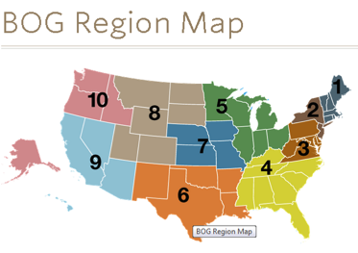
Board of Governors (BOG)
Established in 1982 as a grassroots member network within the AAO-HNS.
Composed of local, state, specialty, and national otolaryngology–head and neck surgery societies.
Functions as a conduit of information between BOG members, the BOG Executive Committee, the AAO-HNS/F Boards of Directors, and the general membership.
All AAO-HNS active members are eligible to apply to become a member of a BOG Committee or attend BOG Committee meetings.
BOG Legislative Affairs Committee
BOG Socioeconomic & Grassroots (SEGR) Committee
BOG Governance & Society Engagement Committee
Each affiliated BOG society has three designated positions to the BOG – Governor, Legislative Rep, and SEGR Rep.
Organized into 10 Geographic Regions – Each region has an appointed representative to the SEGR Committee to enhance and facilitate communications.
Notes:
Functions as a conduit of information:
Identify issues impacting the practice of otolaryngology
Make recommendations regarding the programs and policies of the AAO-HNS
Seek out and involve all otolaryngologists
Strengthen the AAO-HNS and otolaryngology societies
Support the general good of patients, the specialty, and the medical profession
Representation in the BOG:
In their liaison role, a society’s designated individuals are primarily responsible for communicating and coordinating information and requests to/from BOG leaders and society members. The BOG Governors are expected to attend the BOG General Assembly during the Leadership Forum & BOG Spring Meeting and the fall annual meeting. In addition, the Legislative and SEGR Representatives are invited to attend their respective BOG committee meetings during the spring and fall meetings.
Organized into 10 Geographic Regions
To enhance and facilitate communications, the BOG reorganized itself into ten (10) geographic regions. Each region has an appointed representative to the BOG SEGR Committee. These enhancements are particularly helpful in states with inactive or new BOG societies. In addition, a specialty society representative has been added to the 10 regional representatives to foster specialty unity and coordination. As issues arise within BOG societies, we encourage the Governor, Legislative Representative, and/or SEGR Representative to reach out to these regional reps, as well as to collaborate with BOG Executive Committee leaders.

Slide 3
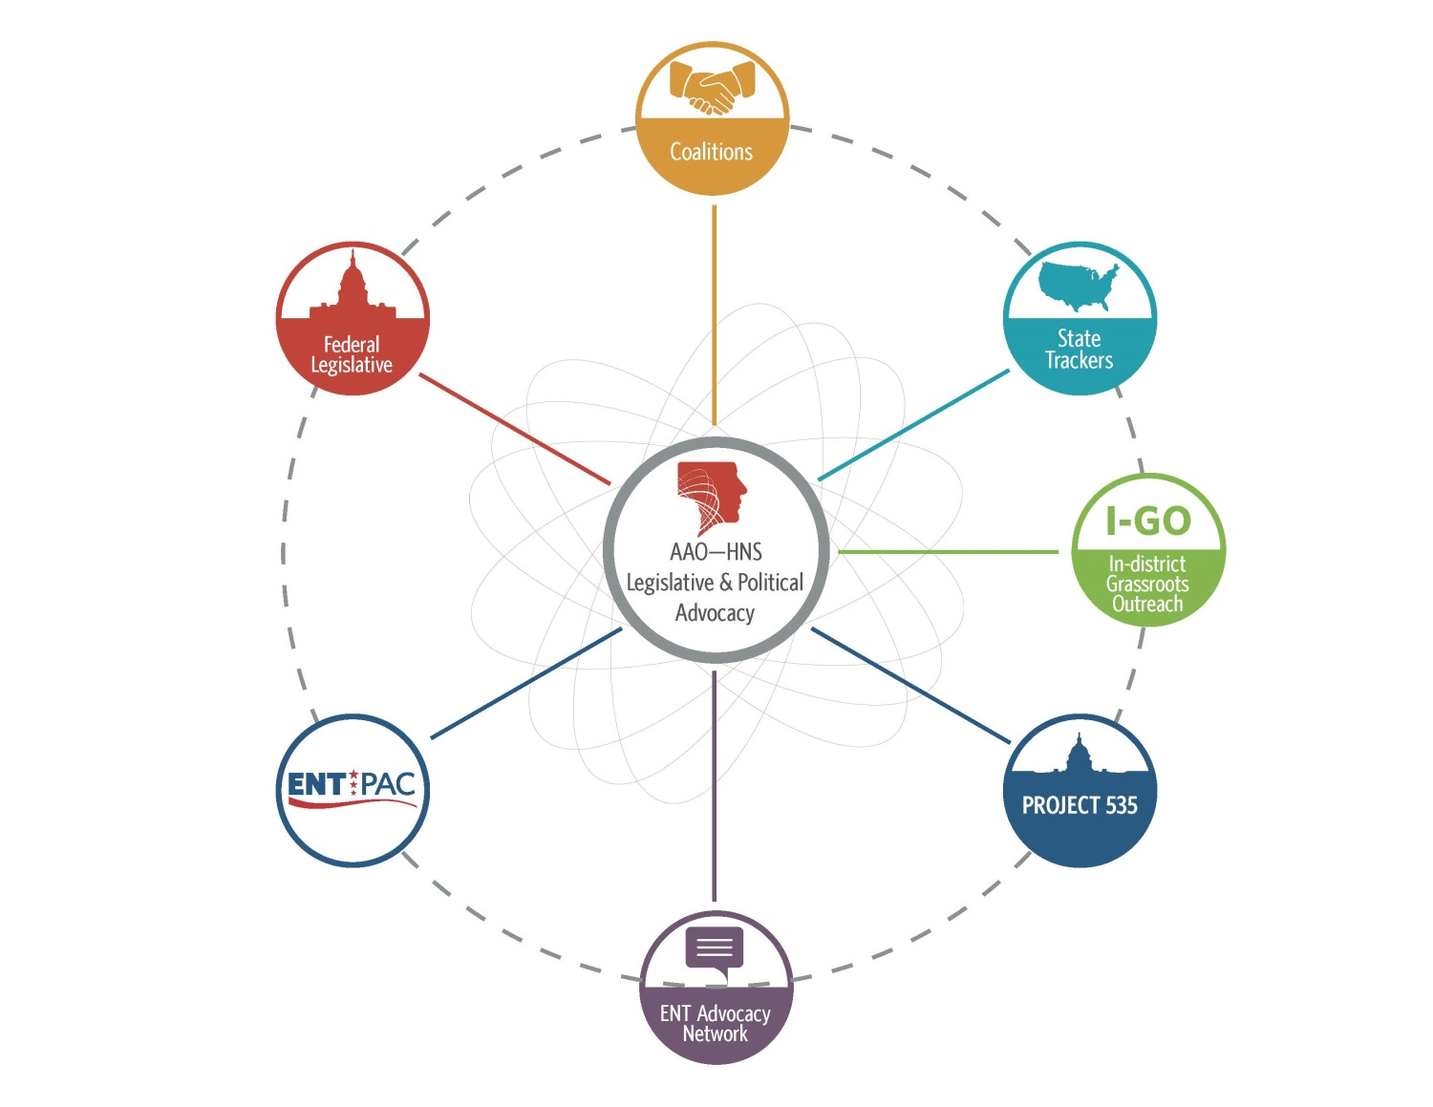
Legislative &
Political Advocacy

Slide 4
Federal Legislative Advocacy
AAO-HNS Key Wins and Legislative Priorities in the 114th Congress
Legislative “Wins” in 2015/16:
Repeal of the flawed Sustainable Growth Rate (SGR) physician payment formula.
Temporary Rescission of CMS policy to convert all 10- and 90-day global payments to 0-day payments.
Consolidation of current performance-based programs (PQRS, VBM, and EHR MU) into a unified Merit-Based Incentive Payment System (MIPS).
Passage of legislation providing expedited hardship exemptions for the MU 2015 reporting period.
Notes:
Update as of 6/10/16:
SGR: On April 16, 2015, the President signed H.R. 2, the Medicare Access and CHIP Reauthorization Act (MACRA). This landmark legislation includes provisions addressing several of the AAO-HNS’ legislative priorities, including:
Permanent repeal of the flawed Sustainable Growth Rate (SGR) formula used to determine payments to physicians under the Medicare program;
Temporary rescission of the new CMS policy to transition all 10- and 90-day global payment codes to 0-day codes by 2018; and
Consolidation of current performance-based programs (PQRS, VBM, and EHR MU) into a unified Merit-Based Incentive Payment System (MIPS).
H.R. 2 was passed by the U.S. House of Representatives (392-37) on March 26, 2015 and the U.S. Senate (92-8) on April 14, 2015. Thank you to the AAO-HNS members who contacted their lawmakers on behalf of the specialty while H.R. 2 was advancing through Congress.
With MACRA now in the implementation phase, the AAO-HNS Legislative Advocacy and Health Policy teams are working closely with lawmakers and CMS to ensure the regulations associated with the new law align with Congress’ original intent.
More information is available on the Legislative Advocacy webpage at www.entnet.org/advocacy.
Or, contact the Legislative Advocacy staff at govtaffairs@entnet.org.

Slide 5
Federal Legislative Advocacy:
2016 Initiatives
Opposition to legislation that would inappropriately expand audiology’s scope of practice or re-classify audiologists as “physicians.”
Reauthorization of the Early Hearing Detection and Intervention (EHDI) program.
Support for the FDA’s authority to regulate ALL tobacco products.
Protecting access to allergy immunotherapy and other drugs/medications prepared via in-office compounding.
Preparation of comments to Administration (PCAST/IOM) re: access and affordability of hearing healthcare services.
Preservation and/or expansion of graduate medical education (GME) funding.
Notes:
Update as of 6/10/16:
Audiology: Two audiology scope-related pieces of legislation have been introduced in the 114th Congress. They are:
HR 1116, the Medicare Audiology Services Enhancement Act of 2015, appropriately strengthens the structure for hearing healthcare services in the United States by better aligning Medicare coverage of comprehensive audiology services with current billing and reimbursement standards of other non-physician therapeutic services covered by Medicare (PT, OT, SLP). The AAO-HNS supports.
HR 2519 inappropriately grants audiologists unlimited direct access to Medicare patients without a physician referral and seeks to amend Title XVIII of the Social Security Act to include audiologists in the definition of “physician.” The AAO-HNS strongly opposes.
Since past efforts to advance legislation in Congress pertaining to “direct access” have been unsuccessful, some in the audiology community are also pursuing scope expansion/direct access via regulatory avenues.
EHDI: Legislation (HR 1344) to reauthorize the EHDI program was passed by the U.S. House of Representatives (via voice vote) in September 2015. A companion bill was introduced in the U.S. Senate (S. 2424) on December 18, 2015. The AAO-HNS, and others in the hearing healthcare community, are working to ensure advancement of this critical legislation this year.
More information is available on the Legislative Advocacy webpage at www.entnet.org/advocacy.
Or, contact the Legislative Advocacy staff at govtaffairs@entnet.org.

Slide 6
Strengthening our Message:
Coalitions
The AAO-HNS actively participates in numerous coalitions to further strengthen our voice to advance the Academy’s state and federal legislative priorities, including:
Surgical Coalition
Deaf and Hard of Hearing Alliance (DHHA)
Friends of the Congressional Hearing Health Caucus (FCHHC)
Health Coalition on Liability and Access (HCLA)
PARTNERS (tobacco-related issues)
Truth-in-Advertising Coalition
IPAB Repeal Coalition
Coalition for Patient Centered Imaging (CPCI)
GME and Workforce Coalition
Button Battery Taskforce

Slide 7
State & Grassroots Advocacy
Nearly 130 AAO-HNS volunteers monitoring legislation in 45 states.
Connecting the AAO-HNS, our members, and state/local medical societies for better coordination and collaboration.
Recruiting volunteers for Alaska, Idaho, Mississippi, Nevada, and South Dakota.
I-GO - Dedicated to finding opportunities for AAO-HNS members to meet LOCALLY with candidates and elected officials.
More than 40 events held since program’s launch in Fall 2013.
Participate in face-to-face meetings, practice visits, fundraisers, townhalls, etc.
Join a network of more than 1900 of your colleagues to receive the latest updates on legislative and political activities.
Receive The ENT Advocate – a FREE member benefit!

Slide 8
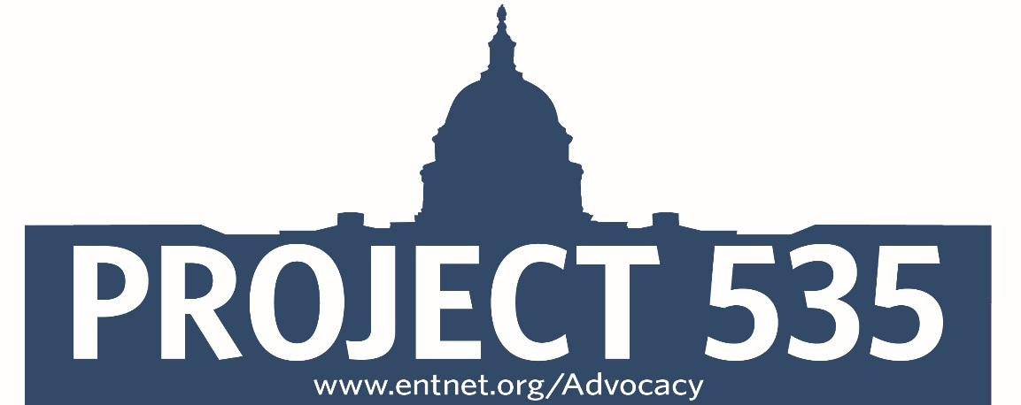
PROJECT 535
BOG-sponsored advocacy initiative launched in September 2015.
Goal: Recruit “key contacts” for all Members of Congress
435 members of the U.S. House of Representatives
100 members of the U.S. Senate
Territories (6) also included.
Purpose: By using coordinated email and phone campaigns, we can improve our outreach to federal legislators when major issues impacting the specialty are debated by Congress.

Slide 9
PROJECT 535
Project 535 Cont’
New Mexico
Senator Marin Heinrich Karen Hawley, MD
Senator Tom Udall _______________
Rep Michelle Lujan Grisham Karen Hawley MD
Rep Steve Pearce _______________
Rep Ben Ray Lujan **** _______________

Slide 10
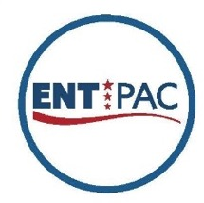
Political Advocacy
ENT PAC, the political action committee of the AAO-HNS, is a NON-PARTISAN, ISSUE-DRIVEN entity created to advance and protect the specialty’s interests on Capitol Hill.
The stronger our PAC (dollars raised, number of Investors), the stronger our collective voice on our federal legislative priorities.
Reminder: AAO-HNS membership dues cannot be used for political purposes.
Visit www.entpac.org to donate for 2016.*
*Contributions to ENT PAC are not deductible as charitable contributions for federal income tax purposes. Contributions are voluntary, and all members of the American Academy of Otolaryngology-Head and Neck Surgery have the right to refuse to contribute without reprisal. Federal law prohibits ENT PAC from accepting contributions from foreign nationals. By law, if your contributions are made using a personal check or credit card, ENT PAC may use your contribution only to support candidates in federal elections. All corporate contributions to ENT PAC will be used for educational and administrative fees of ENT PAC, and other activities permissible under federal law. Federal law requires ENT PAC to use its best efforts to collect and report the name, mailing address, occupation, and the name of the employer of individuals whose contributions exceed $200 in a calendar year.
Notes:
Update as of 6/16
Log-in to the PAC webpage using the SAME user ID and password used for the AAO-HNS website. The log-in is NOT email-based.
The goal for the 2015-2016 election cycle (January 2015-December 2016) is to raise approximately $400,000.
ENT PAC “membership” runs on a calendar-year basis and a list of PAC Investors is posted/updated on the – www.entpac.org – at the end of every month.
ENT PAC staff can be reached at entpac@entnet.org.

Slide 11
BOG SOCIOECONOMIC AND GRASSROOTS COMMITTEE
BOG SEGR GOALS
Monitor Socioeconomic issues facing otolaryngologists
Grassroots interaction to help local physicians
BOG POLLING
Inquire about local problems and issues
Become a filter for local and regional issues
BOG REGIONAL REPRESENTATIVES
Facilitate regional discussions and identify trends
BOG Linking Solutions with Problems
Identify problems
Find other societies which have solved these problems
Reduce effort and gain from national experiences

Slide 12
BOG SOCIOECONOMIC AND GRASSROOTS COMMITTEE
BOG POLLING Examples
Pediatric Subcertification
Accountable Care Organizations
ACA Problems and Challenges
Emergency Room Call
Your Suggestions for next ones in 2017?
____________________________________

Slide 13
Board of Governors (BOG)
REGIONAL REPRESENTATIVE SYSTEM
10 Regions and 1 Subspecialty Region
Collates local and regional
Problems
Finding local solutions
New Mexico: Region 6: Larry Simon
Notes:
Functions as a conduit of information:
Identify issues impacting the practice of otolaryngology
Make recommendations regarding the programs and policies of the AAO-HNS
Seek out and involve all otolaryngologists
Strengthen the AAO-HNS and otolaryngology societies
Support the general good of patients, the specialty, and the medical profession
Representation in the BOG:
In their liaison role, a society’s designated individuals are primarily responsible for communicating and coordinating information and requests to/from BOG leaders and society members. The BOG Governors are expected to attend the BOG General Assembly during the Leadership Forum & BOG Spring Meeting and the fall annual meeting. In addition, the Legislative and SEGR Representatives are invited to attend their respective BOG committee meetings during the spring and fall meetings.
Organized into 10 Geographic Regions
To enhance and facilitate communications, the BOG reorganized itself into ten (10) geographic regions. Each region has an appointed representative to the BOG SEGR Committee. These enhancements are particularly helpful in states with inactive or new BOG societies. In addition, a specialty society representative has been added to the 10 regional representatives to foster specialty unity and coordination. As issues arise within BOG societies, we encourage the Governor, Legislative Representative, and/or SEGR Representative to reach out to these regional reps, as well as to collaborate with BOG Executive Committee leaders.

Slide 14
BOG SEGR Handouts for local societies

Slide 15
BOG Society Engagement and Governance
BOG Society Engagement and Governance Goals
Help to build new state and local societies (6 states)
Help to use virtual societies where geography is a limiting factor
Help to build better and more productive societies
BOG Society Engagement and Governance Resources
Handouts on the BOG site on ENTConnect
“Bring Home the Academy” slides for BOG Governors to use at their home societies
Linking smaller societies with sister societies around the country
Connecticut Society
Virginia Society
Massachusetts Society

Slide 16
BOG Societies
Importance of Involvement
BOG Society: Why become one of the 94 local, regional, and national societies
Can participate in BOG committees
Can give opinions on SEGR polls
Can be involved in the many Leg Affairs programs
Can link with other societies to find solutions to local problems
Can have access to Academy leadership on important issues
Can go to spring leadership meeting to meet other BOG members from around the country
Can be involved at any level from resident to young physician to mature otolaryngologist
Can help to define the strategic goals of the Academy

Slide 17
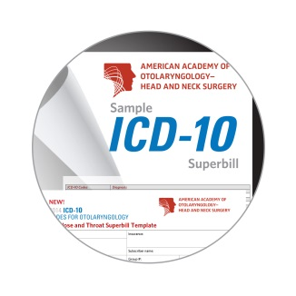
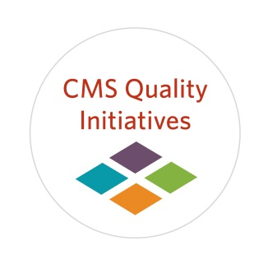
New Academy Initiatives: Health Policy Resources
AAO-HNS ICD-10 Resources
ICD-10 ENT Superbill Template Available (Over 590 specialty relevant ICD-10 Codes)
Crosswalk of ICD-9 to ICD-10 Commonly Used ENT Codes
www.entnet.org/content/icd-10-coding-resources
Foundation-sponsored Coding and Practice Management Workshops and Webinars
New & Updated Academy Fact Sheets
Electronic Health Record Incentive Program Fact Sheet
Electronic Prescribing Incentive Program Fact Sheet
Physician Quality Reporting System Fact Sheet
Value Based Payment Modifier Fact Sheet
Physician Compare Fact Sheet
PQRSWizard
Successful submitters will receive .5% bonus and avoid the -2% penalty in 2016
http://www.entnet.org/content/pqrswizard
Notes:
The AAO-HNS Foundation has partnered with AAPC to offer Foundation-sponsored Coding and Practice Management learning opportunities at a special rate for Members.
PQRSWizard
A fast, convenient, and cost-effective online tool to help collect and report quality measure data for the CMS PQRS incentive program.
PQRSWizard features individual quality measures in the areas of otolaryngology and allergy & immunology.

Slide 18
Address critical member needs in the domains of quality reporting for Medicare.
Document the value of care our members provide their patients.
Allow for tracking of patient outcomes over time.
Help members negotiate effectively with private payers.
Assist with the development of alternative payment models.
Facilitate requirements of Maintenance of Certification/Licensure.
Allow for the development of relevant specialty-specific performance measures.
Enable post-market product surveillance capabilities.

Slide 19
www.academyu.org
Notes:
AcademyU.org provides easy access to a variety of education opportunities including 100s of courses in the AU catalog, networking in the AU community, shared education information in Resource Share, and 24/7 access to you your education transcript.

Slide 20
AAO-HNS: 3P Committee
Interactions with Insurance Companies

Slide 21
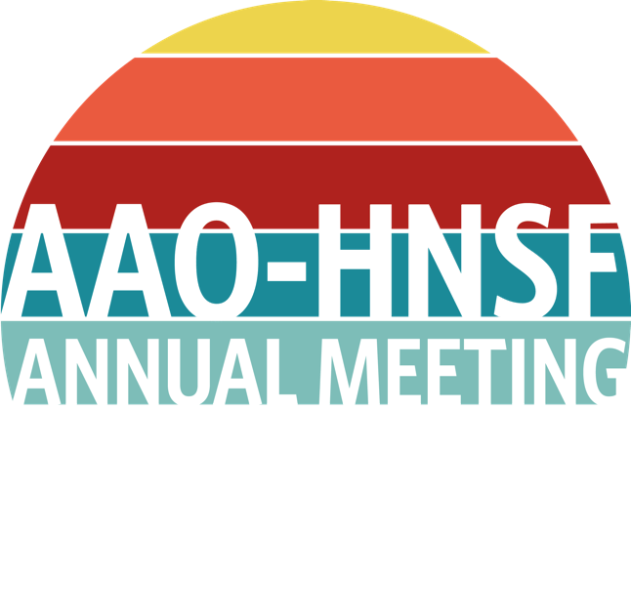
Join Us in San Diego, CA September 18-21, 2016
REGISTER NOW!
September 18-21, 2016
San Diego, CA

Slide 22
SAVE THE DATE – Mark your calendars to join your colleagues at the 2017 AAO-HNS/F Leadership Forum & BOG Spring Meeting!
Date: Saturday, March 11-13, 2017
Location: The Westin Alexandria Hotel 400 Courthouse Square Alexandria, VA 22314
Cost: FREE to AAO-HNS Members
CME Credits Available

Slide 23
BOARD OF GOVERNORS
BOG Leadership
BOG Societies
AAO/HNS Members
Project 535, State Trackers, ENT PAC
BOG Executive Committee
Society Reps: Governor, Legislative, SEGR
Regional Representatives
BOG Committees

Slide 24
Thank you
David R. Edelstein, M.D.
Chair, Board of Governors
entdre@aol.com
917-697-0641
BOG meets on the Saturday before Annual Meeting
BOG General Assembly on Monday 5-7 pm during Annual Meeting

